Slide 1
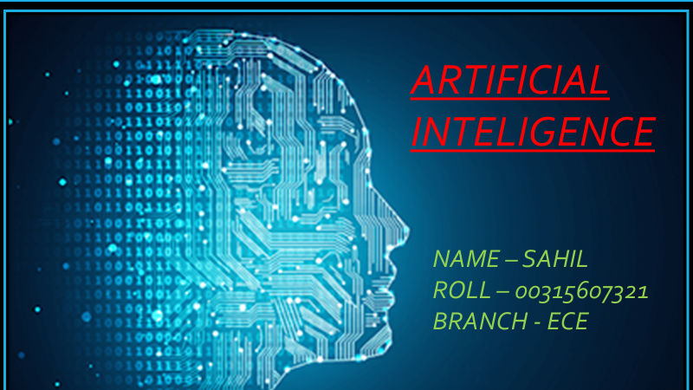
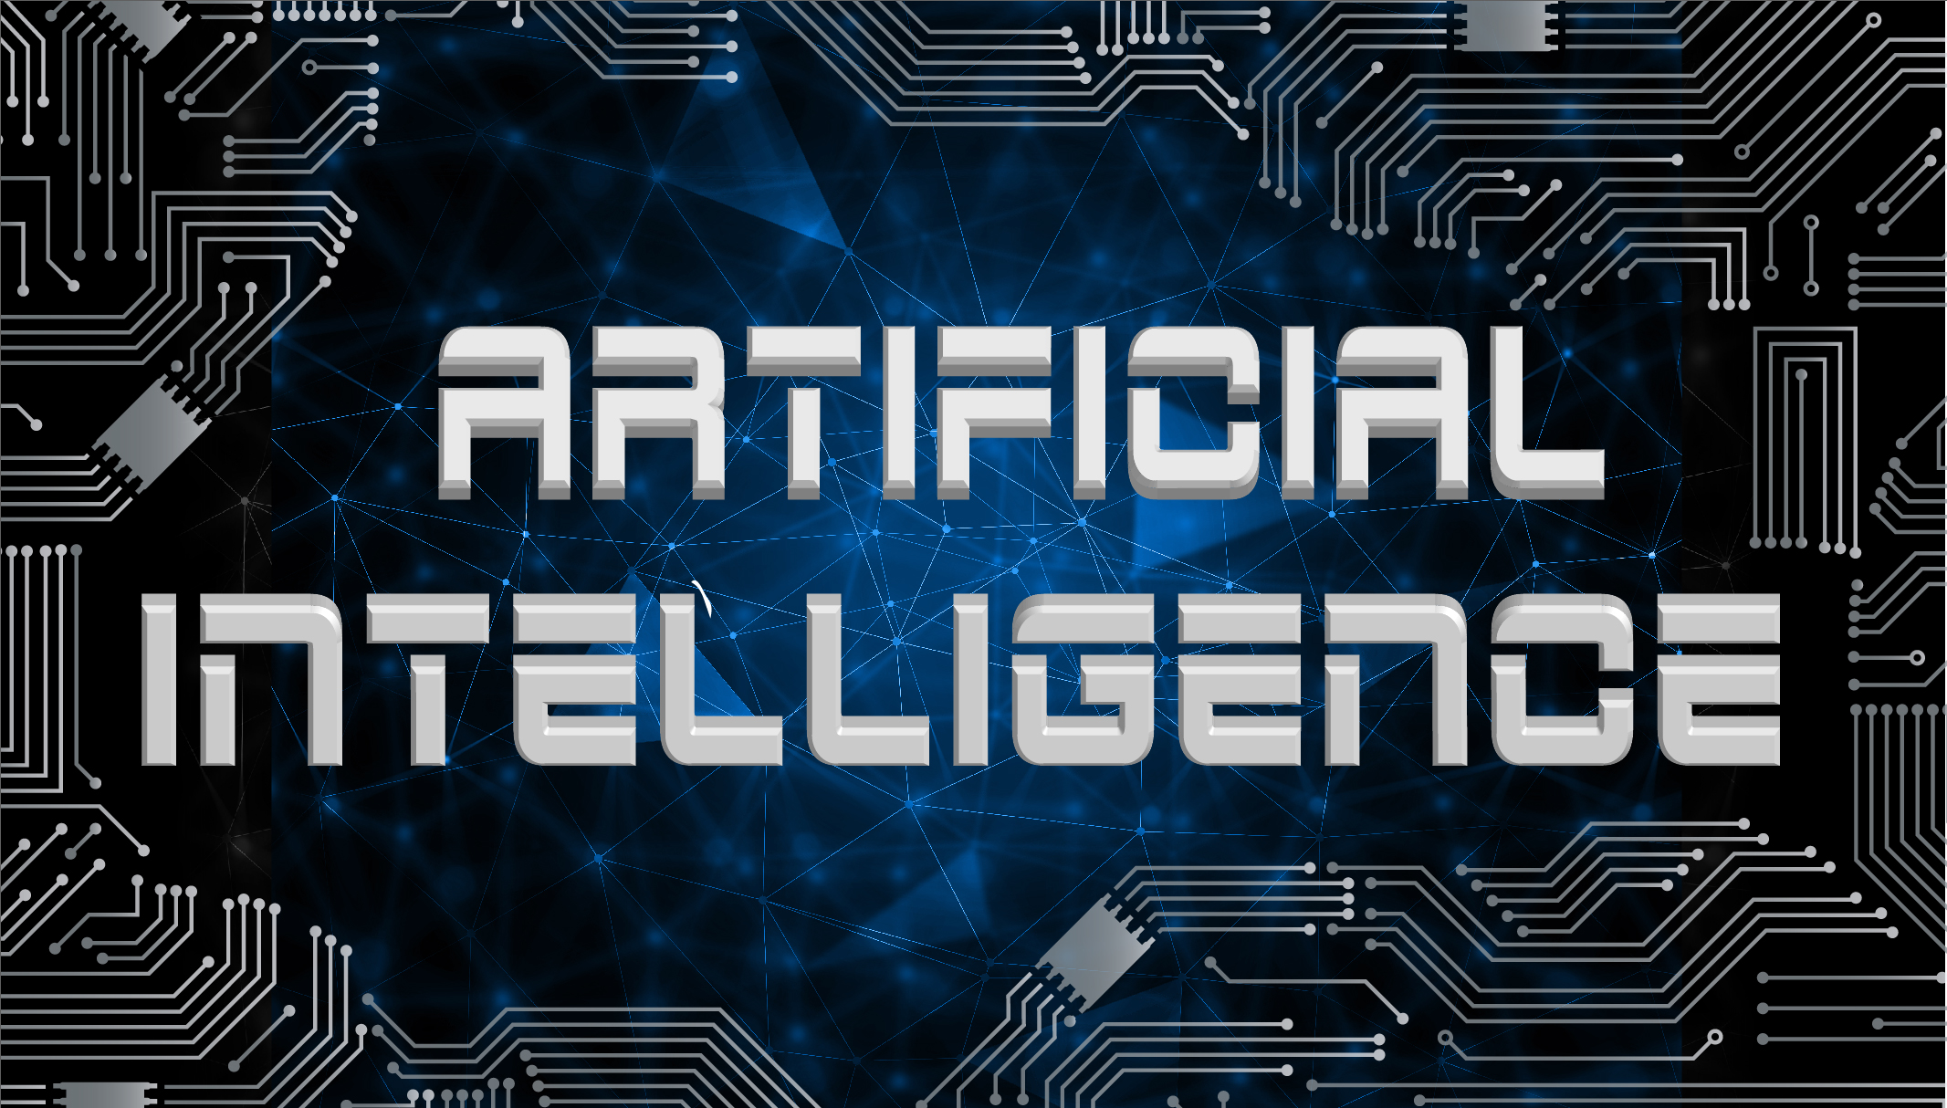

Slide 2
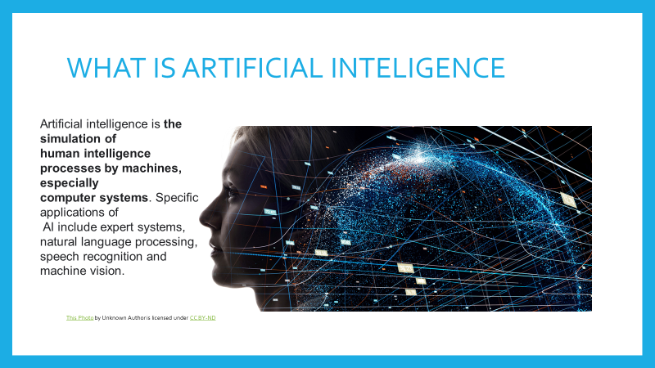


Slide 3

WHAT ARE THE MAIN GOALS OF AI
At its core, Al reads human behavior to develop intelligent machines. Simply put, the foundational goal of Al is to design a technology that enables computer systems to work intelligently yet independently.
This Photo by Unknown Author is licensed under CC BY

Slide 4

How Does AI Works Basics
Al systems work by combining large sets of data with intelligent, iterative processing algorithms to learn from patterns and features in the data that they analyze. Each time an Al system runs a round of data processing, it tests and measures its own performance and develops additional expertise.
This Photo by Unknown Author is licensed under CC BY-SA-NC

Slide 5
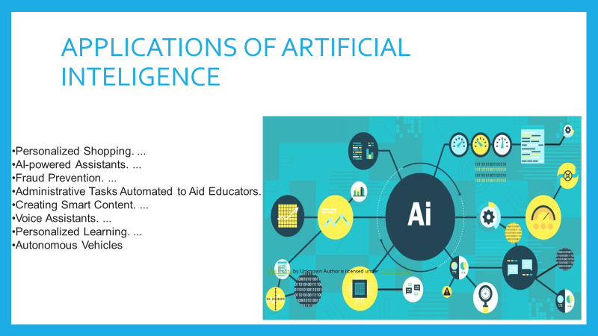


Slide 6
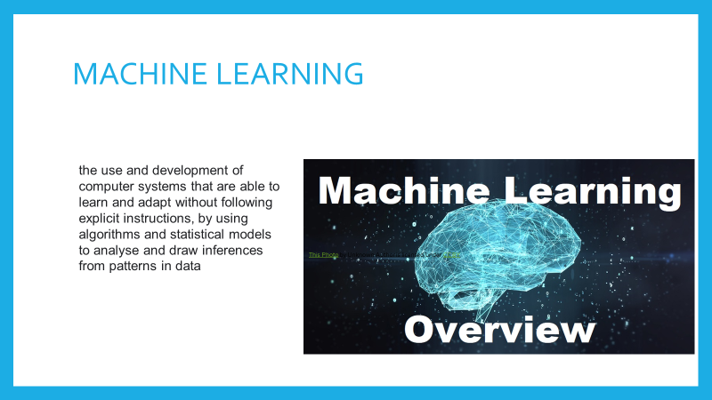

Slide 7
Machine learning (ML) is a type of artificial intelligence (AI) that allows software applications to become more accurate at predicting outcomes without being explicitly programmed to do so. Machine learning algorithms use historical data as input to predict new output values
Simply put, machine learning allows the user to feed a computer algorithm an immense amount of data and have the computer analyze and make data driven recommendations and decisions based on only the input data.
Machine Learning is an Al technique that teaches computers to learn from experience. Machine learning algorithms use computational methods to "learn" information directly from data without relying on a predetermined equation as a model.

Slide 8
SUPERVISED MACHINE LEARNING
It is defined by its use of labeled datasets to train algorithms that to classify data or predict outcomes accurately.
'In supervised machine learning the model learns the relationship between the labelled input and output data.
'-There are two types of Supervised Learning techniques: Classification and Regression.
-Regression is a technique for investigating the relationship between independent variables or features and a dependent variable or outcome.
-Classification is the task of predicting a discrete class label. Regression is the task of predicting a continuous quantity Data classification is the process of organizing data by relevant categories, to make it easy to find, store, and analyze

Slide 9
UNSUPERVISED MACHINE LEARNING
unsupervised machine learning, uses machine learning algorithms to analyze and cluster unlabeled datasets. These algorithms discover hidden patterns or data groupings without the need for human intervention.
Unsupervised learning is commonly used for finding meaningful patterns and groupings inherent in data, extracting generative features, and exploratory purposes.
Clustering and Association are two types of Unsupervised learning
Clustering or cluster analysis is a machine learning technique, which groups the unlabelled dataset
Association rule learning is a rule-based machine learning method for discovering interesting relations between variables in large databases
Association learning is a rule based machine learning that finds important relations between variables or features in a data set.

Slide 10
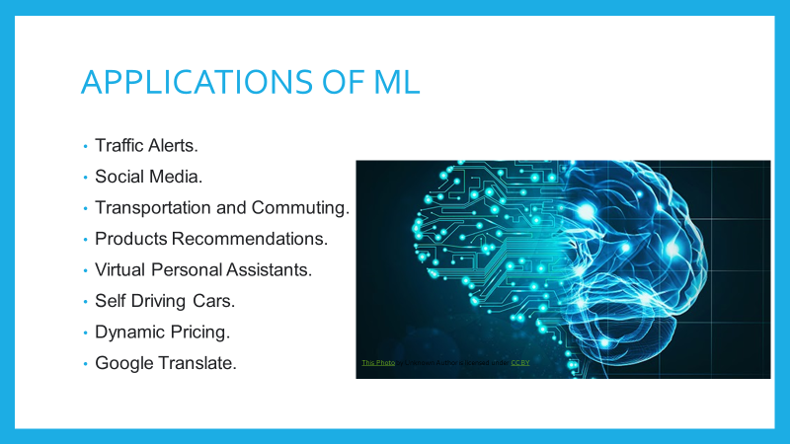

Slide 11
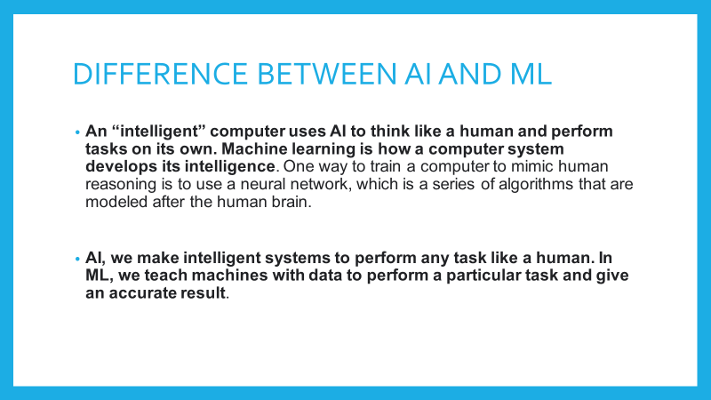

Slide 12
PANDAS
Pandas is defined as an open-source library that provides high-performance data manipulation in Python. , It is built on top of another package named Numpy, which provides support for multi-dimensional arrays. , It is used for working with data sets. It has functions for analyzing, cleaning, exploring, and manipulating data. ,We can use Pandas to perform various tasks like filtering your data according to certain conditions, or segmenting and segregating the data according to preference, etc.
Pip install pandas
import pandas as pd
import numpy as np
-Ye data ko local disc se ram me daldeta hai jisse computational power increase ho jati h

Slide 13
ADVANTAGES OF PANDAS
it has Customizable indexed data frame objects
-Efficiently handles large data
-Makes data flexible and customizable

Slide 14
NUMPY

